Slide 1
Center for Excellence in Education
Virtual Bite of Science - Pennsylvania
Presented by:
Sean Mulvehill, CPA MBA – Chief Financial Officer
Paul Serkosky, P.E. - Director of Engineering

Slide 2
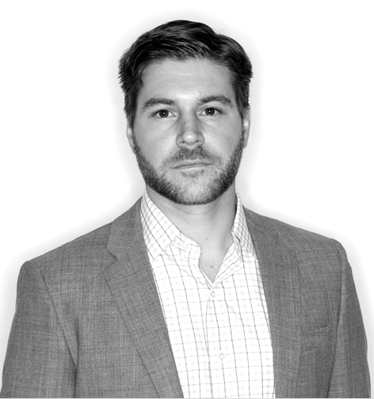
Sean Mulvehill, CPA MBA - Chief Financial Officer
B.S. Accounting from State University of New York
Master of Business Administration from Trinity College Dublin
Certified Public Accountant, Lean Six Sigma Black Belt
Mountain Productions, 2016 to Present
Paul Serkosky, P.E. - Director of Engineering
B.S. Mechanical Engineering from Wilkes University
Licensed civil and structural engineer in 44 states
Mountain Productions, 1994 to Present

Slide 3
Mountain Productions – Virtual Bite of Science
Mountain Productions
Four Main Verticals
Pivoting in a COVID-19 Landscape
Engineering for Entertainment
Foo Fighters
Initial Project
Unanticipated Challenge
Result

Slide 4
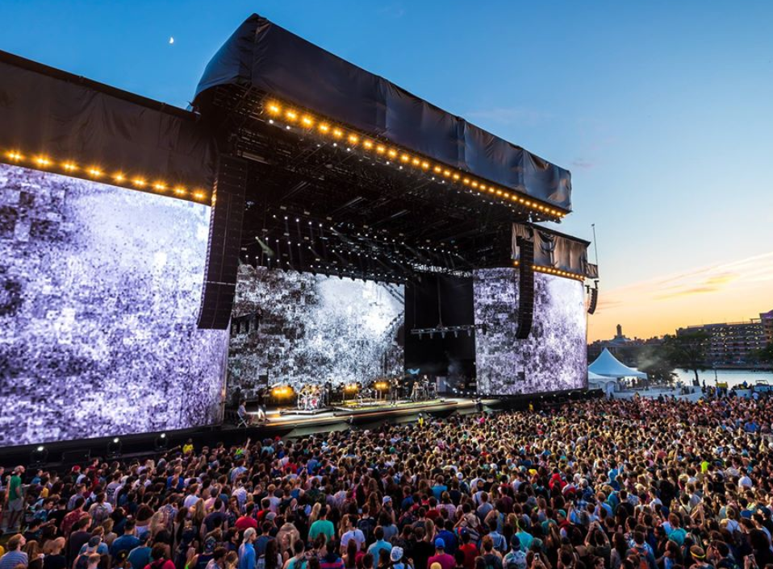
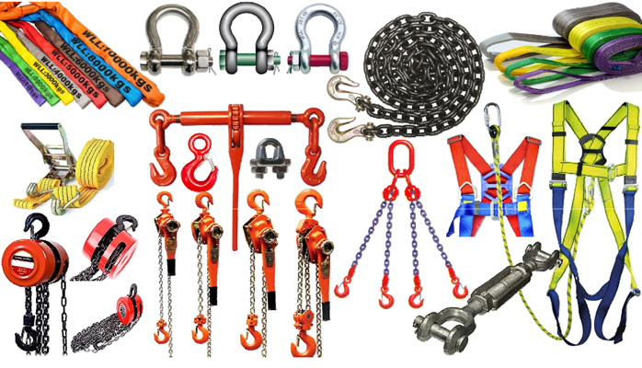
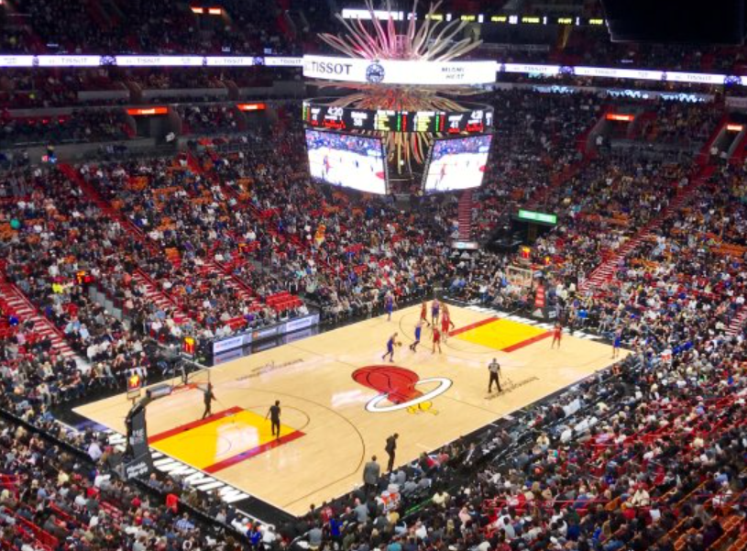
Mountain Productions Verticals
Staging Sales
Rigging Sales
Permanent Installations
E-Commerce

Slide 5
Mountain Productions Verticals
45%
15%
35%
5%
Staging Sales
Permanent Installations
Rigging Sales
E-Commerce

Slide 6
COVID-19 Response
Staging Sales*
Rigging Sales*
Freight Contracts
PPE Manufacture and Sale
Medical Testing Units
Staging Sales
Rigging Sales
* Not to Scale

Slide 7
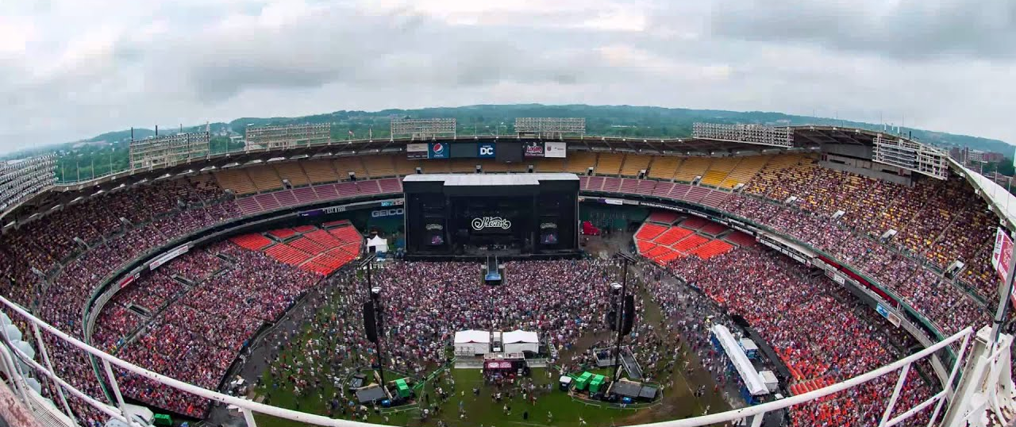
Engineering - Project Life Cycle – Foo Fighters
Event: Foo Fighters 20th Anniversary Show
Rigging Plot Provided: 12/05/2014
Event Date: 7/4/2015
Event Location: RFK Memorial Stadium, Washington D.C.

Slide 8
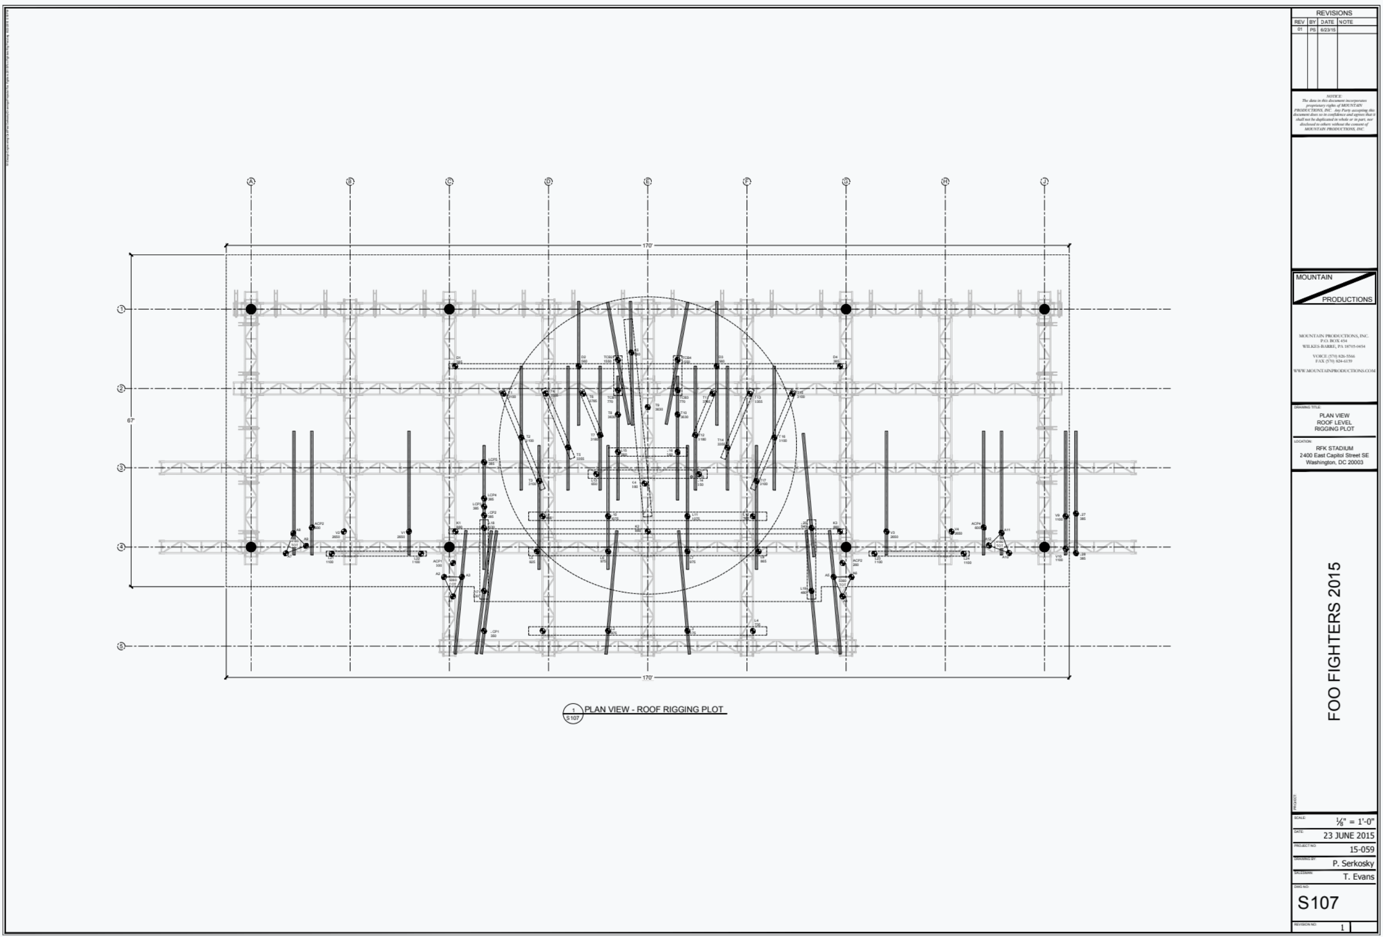
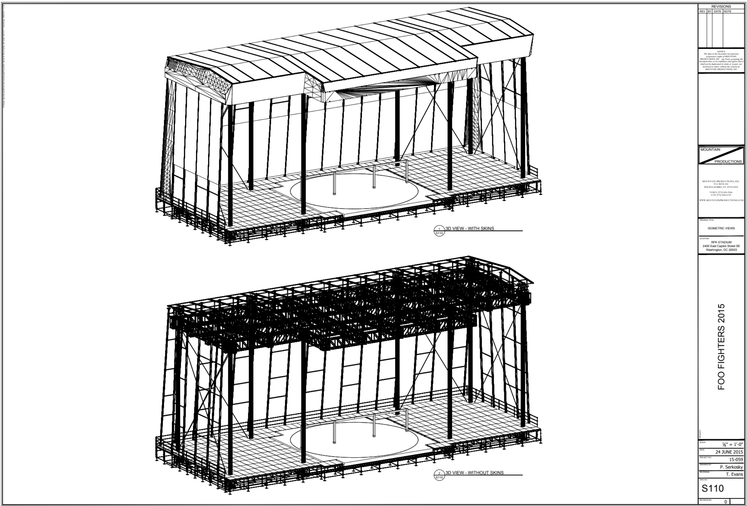
Engineering - Project Life Cycle – Foo Fighters
Event: Foo Fighters 20th Anniversary Show
Rigging Plot Provided: 12/05/2014
Event Date: 7/4/2015
Event Location: RFK Memorial Stadium, Washington D.C.

Slide 9
Engineering - Project Life Cycle – Foo Fighters
Event: Foo Fighters 20th Anniversary Show
Rigging Plot Provided: 12/05/2014
Event Date: 7/4/2015
Event Location: RFK Memorial Stadium, Washington D.C.

Slide 10
Engineering - Project Life Cycle – Foo Fighters
Event: Foo Fighters 20th Anniversary Show
Rigging Plot Provided: 12/05/2014
Event Date: 7/4/2015
Event Location: RFK Memorial Stadium, Washington D.C.
Unanticipated Challenge:
Dave Grohl (Lead Singer of band) breaks leg during concert on 6/12/2015

Slide 11
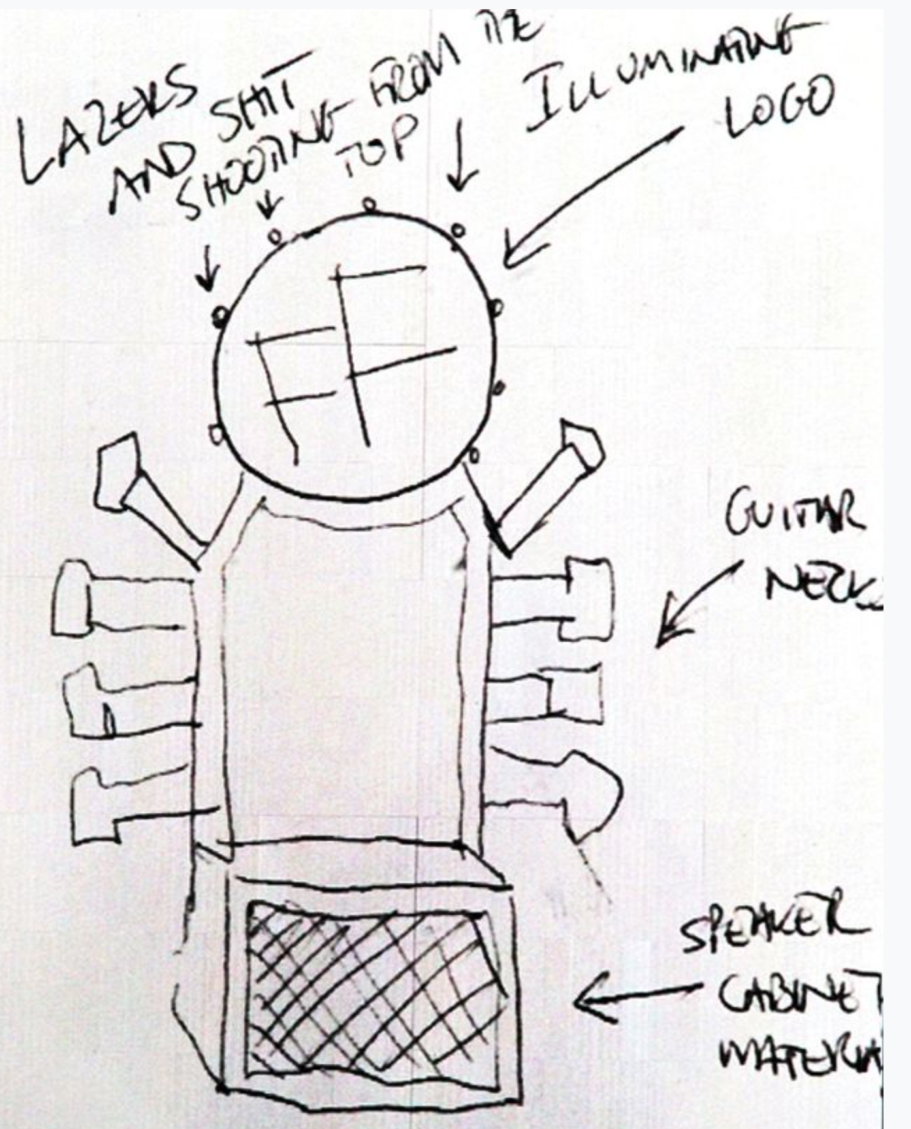
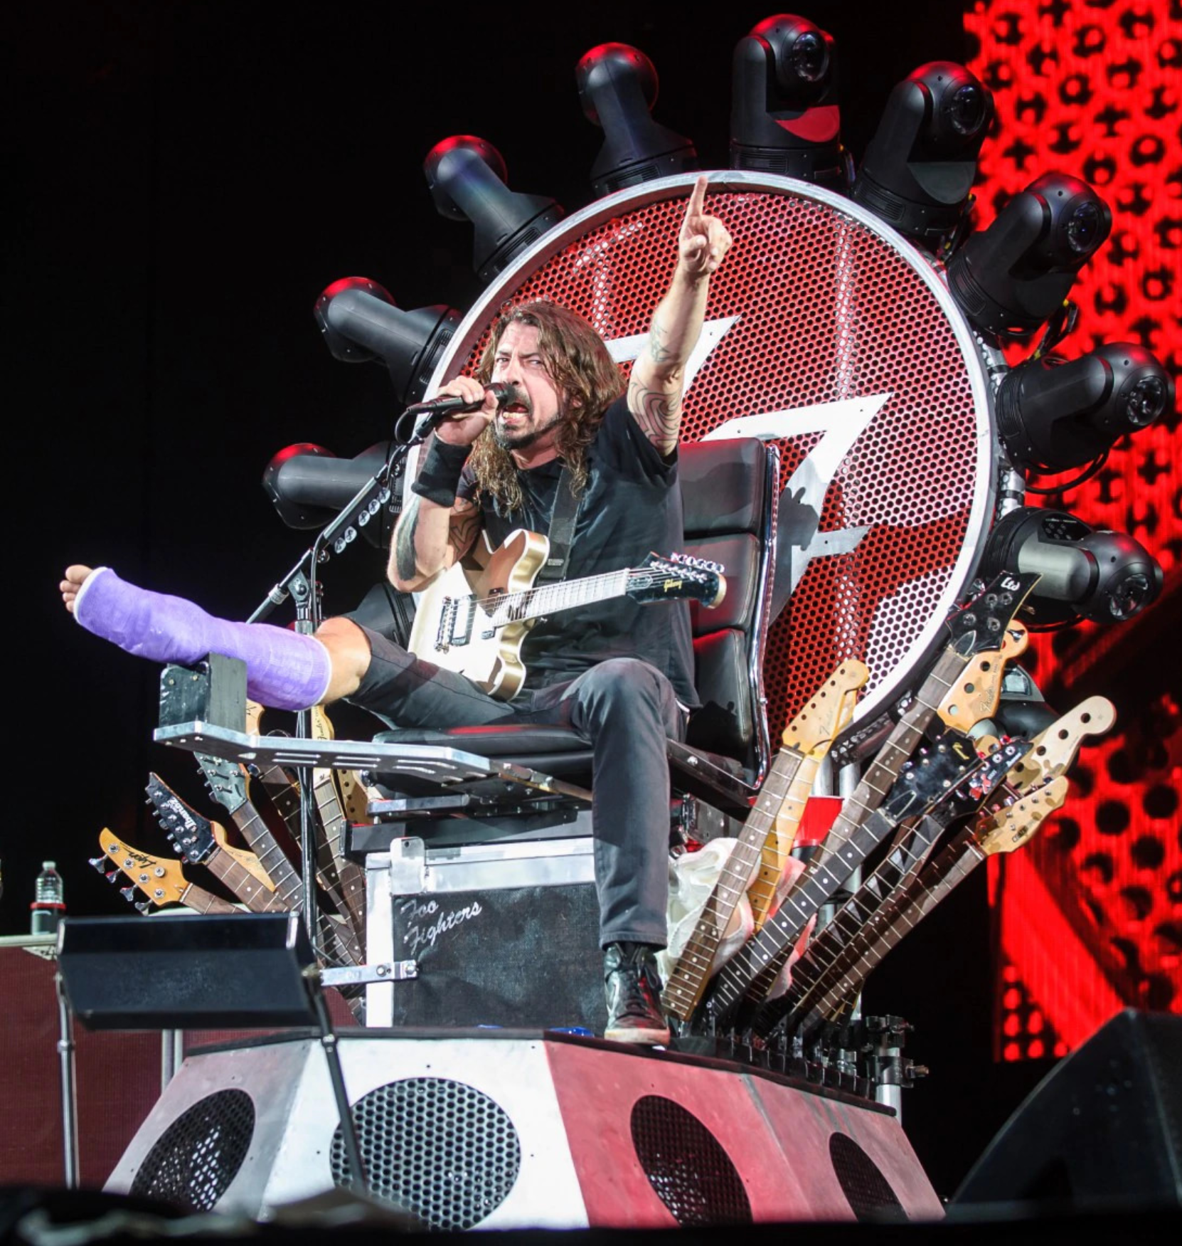
Engineering - Project Life Cycle – Foo Fighters
Event: Foo Fighters 20th Anniversary Show
Rigging Plot Provided: 12/05/2014
Event Date: 7/4/2015
Event Location: RFK Memorial Stadium, Washington D.C.
Unanticipated Challenge:
Dave Grohl (Lead Singer of band) breaks leg during concert on 6/12/2015

Slide 12
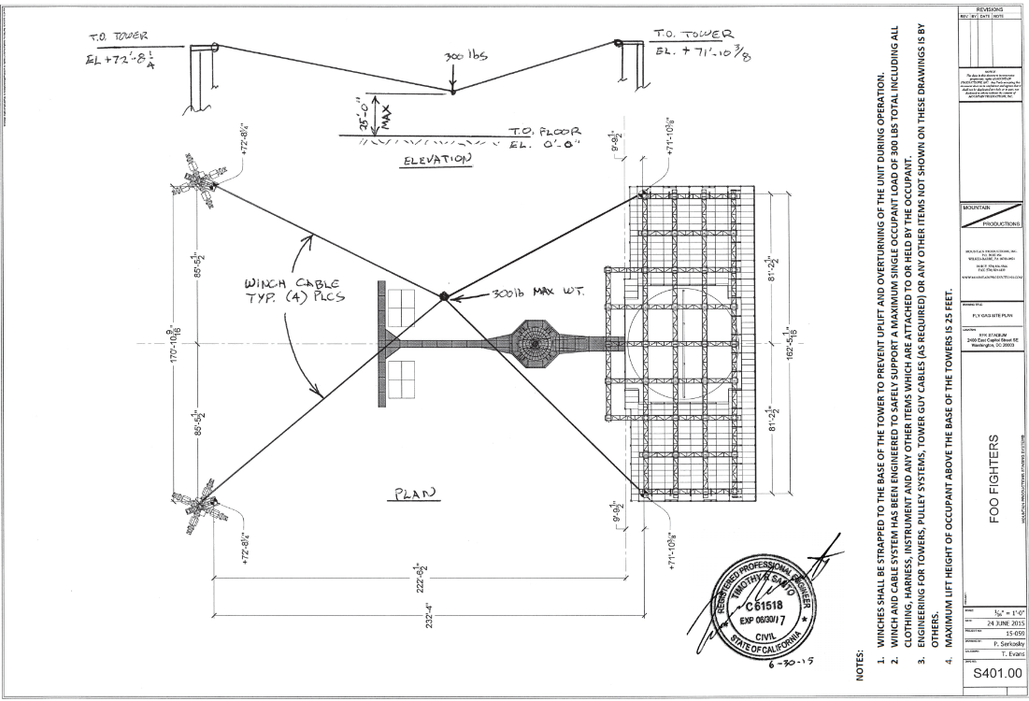
Engineering - Project Life Cycle – Foo Fighters
Event: Foo Fighters 20th Anniversary Show
Rigging Plot Provided: 12/05/2014
Event Date: 7/4/2015
Event Location: RFK Memorial Stadium, Washington D.C.
Unanticipated Challenge:
Dave Grohl (Lead Singer of band) breaks leg during concert on 6/12/2015

Slide 13
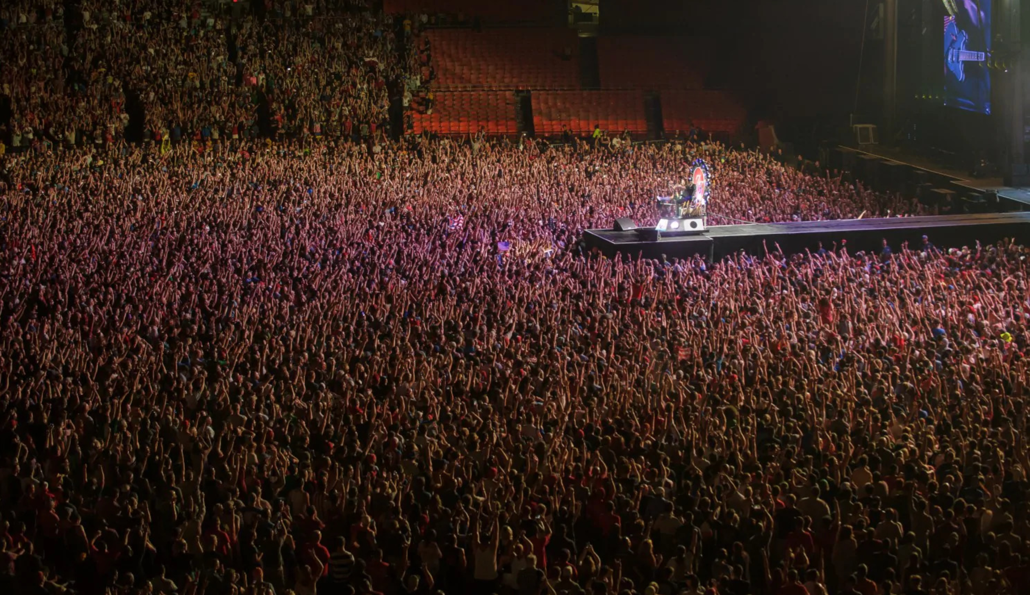
Engineering - Project Life Cycle – Foo Fighters
Event: Foo Fighters 20th Anniversary Show
Rigging Plot Provided: 12/05/2014
Event Date: 7/4/2015
Event Location: RFK Memorial Stadium, Washington D.C.

