Slide 1
STEM Careers Webinar Presentation
ADAM LAAKMANN
Chief Engineer, Aerojet rocketdyne

Slide 2
My STEM Story
Me during my formative elementary school years
Space shuttles!

Slide 3
My STEM Story
Grew up watching shuttle launches from the end up a street in my neighborhood in Orlando
Been sold on rockets ever since
Went to a science/pre-engineering magnet high school in South Florida
Went to UF and earned BSME in 1999
Lucked into a career in rocket propulsion and have been doing it ever since

Slide 4
Where have I worked and what have I done?
Pratt & Whitney Liquid Space Propulsion, WPB, FL (1999-2005)
Systems performance analysis and design optimization for RL60 upper stage engine
RD-180 co-production effort
ATK Tactical Propulsion & Controls, Elkton, MD (2005-2010)
Varied solid propulsion programs, from igniters to oil tools to tech demonstrators to manned space systems to missile defense
Aerojet Rocketdyne, Sacramento, CA & Huntsville, AL (2010-present)
Mostly missile defense, but occasional forays into other things

Slide 5
What does a chief engineer at AR do?
Represents Engineering within program management teams
Leads Engineering teams on development of propulsion systems
Technical interface with customers
Technical lead on proposal efforts
Spend entirely too much time in meetings

Slide 6
STEM skills that have helped me be successful
Math, math, math!
Simple geometry is surprisingly important in solid rocketry
A little bit of trig, a little bit of calculus
Solid foundation in the technical basics – physics, chemistry, thermodynamics, materials, mechanical design
Don’t need to be an expert on any of this coming out of school; just need a good understanding of the fundamentals
Ability to make peace with 95% of everything you learned in school being irrelevant to your job
Your company will take the 5% that’s relevant and build on that to teach what you need to know for your job
Knowing what you don’t know and never being afraid to ask for help from people who know more than you

Slide 7
Advice for students interested in a career in rockets
Participate in rocketry clubs in school
If your school doesn’t have one, start one
Connect with professionals in the industry and seek out mentorships – formal or informal
In college, seek out internships
The job market is extremely competitive right now and the more work experience one can get while in school, the better chance you’ll have of landing a job in industry when they get out

Slide 8
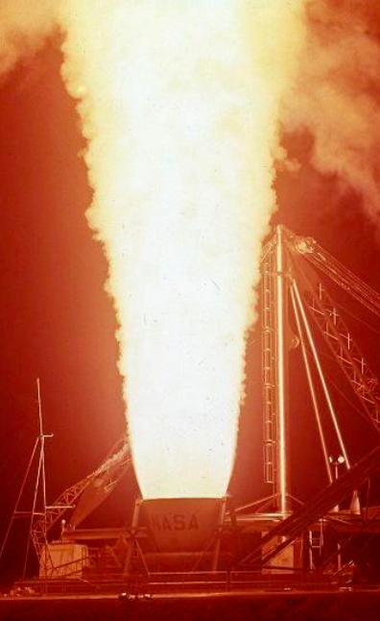
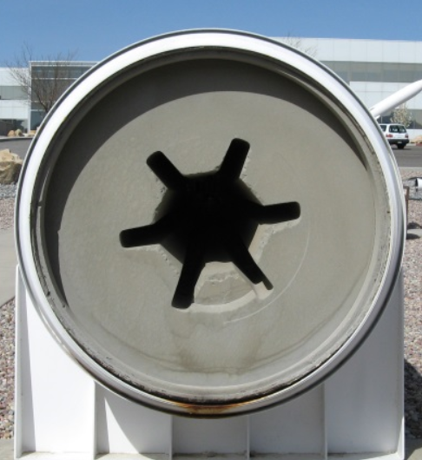
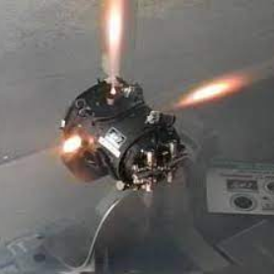
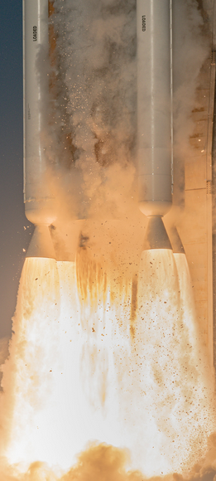
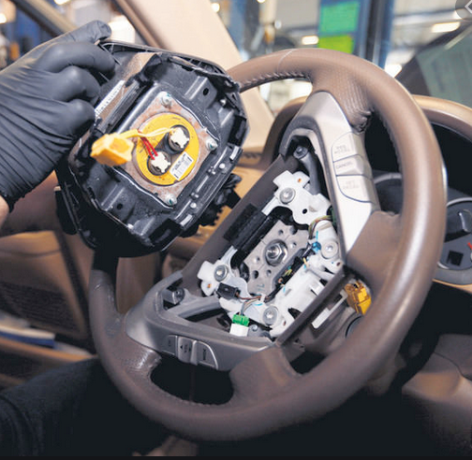
Questions?

