Slide 1
VIRTUAL BITE OF SCIENCE CCEE TEACHER ENRICHMENT PROGRAM September 24, 2020
Joe T. May
Former State Delegate
Chairman of the Board
Chief Technologist, EIT LLC
Leesburg, Virginia

Slide 2
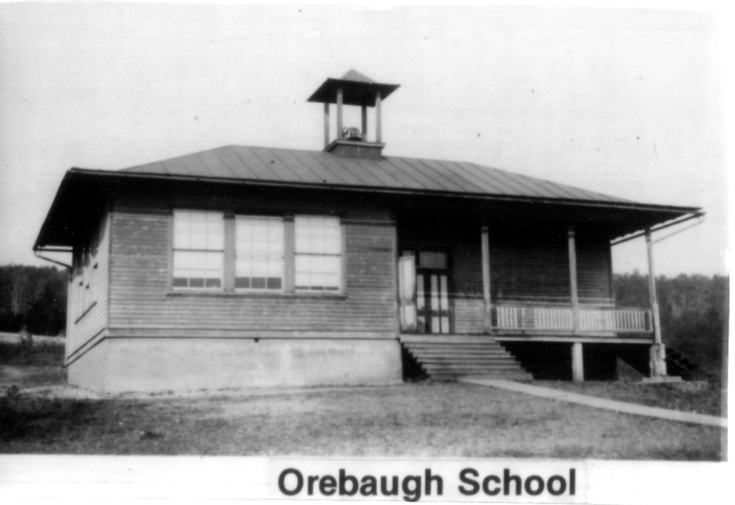
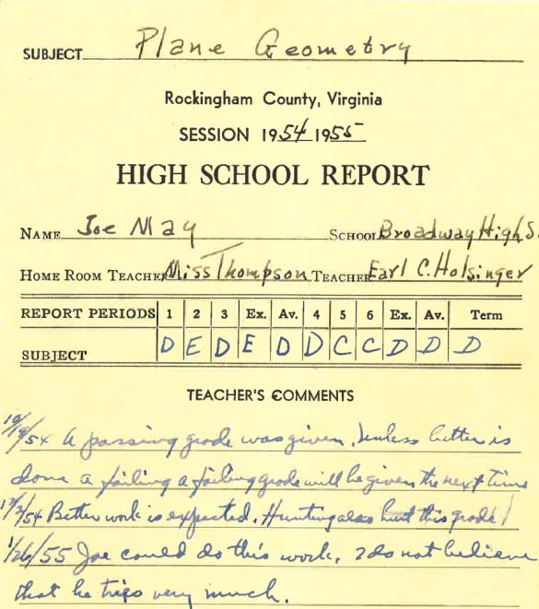
BACKGROUND
Electrical Engineering Graduate, VPI&SU; 58 year career, 28 patents and counting
Born and raised a farmer
Poor High School student; much improved college student.
Introduced to electronics in Army

Slide 3
How did I get to Leesburg?
Entered service (US Army, 3 yrs.)
Attended Electronic School in Service
Went to VA Tech after 3 years service
Worked very hard (19.5 hours) in EE
Residence Counselor; Summer Intern, JHU APL

Slide 4
CAREER
1962 – After graduating VA Tech, first job at Du Pont’s Experimental Station, Wilmington DE. First 3 patents there (6 yrs.)
1969 - Electronic equipment salesman, Rockville, MD (2 yrs.)
1970 - Engineering Supervisor – Rail Research firm, (3 yrs)
1974 - Self employed technical consultant (4 yrs)
Founded EIT (44 yrs)
1994- 2014 – Served in the Virginia House of Delegates

Slide 5
What Is My Job
Electrical Engineer, Business Owner, Public Service
My company, EIT, designs and builds electronic equipment; medical, communication and scientific instruments, etc.
My job requires high level math skills, all basis sciences (chemistry, physics, biology, etc.) and the ability to read and write acceptably well. Hard work and concentration is also required

Slide 6
What Excites Me Professionally
Working on a problem which has required excessive effort to deal with and then producing an economical, convenient solution to the problem. Two examples are on the following slides.
Track Curvature Computer
Road Octane Computer

Slide 7
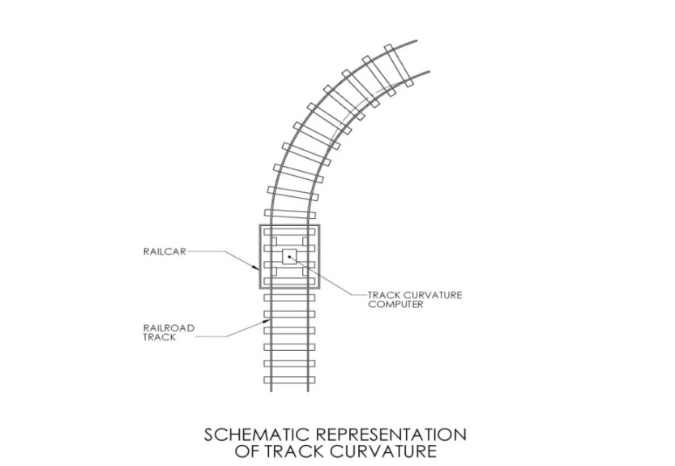
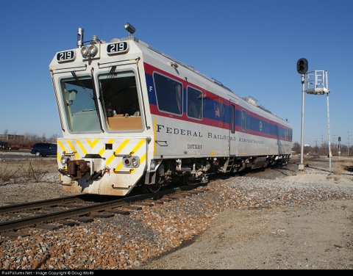
Track Curvature Computer Federal Standard still for Rail Safety

Slide 8
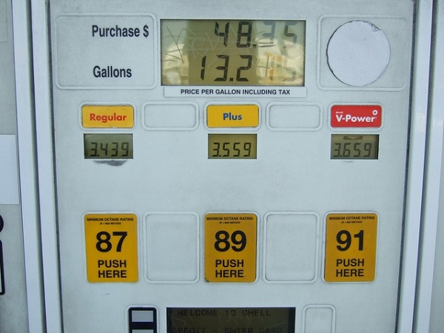
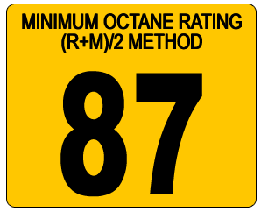
Road Octane Computer ~ Saved many billions over the years ~

Slide 9
What can teachers do to support students interested in STEM professions
Multifaceted Answer
Look for STEM oriented programs which might be available to your students.
VASTS - Virginia Space Grant Consortium*
BLAST - Building Leaders for Advancing Science and Technology
Pathways to Engineering (VA Tech Program)
Science Fairs
Technology Internships
Technology Mentoring Activities
Space Camp
Opportunities of your own creation
Watch for students who may have hidden talents in the STEM area to mentor. (example EIT employees)
*Virginia Space Grant Consortium knows of internship possibilities (Mary Sandy – see following photo)

Slide 10
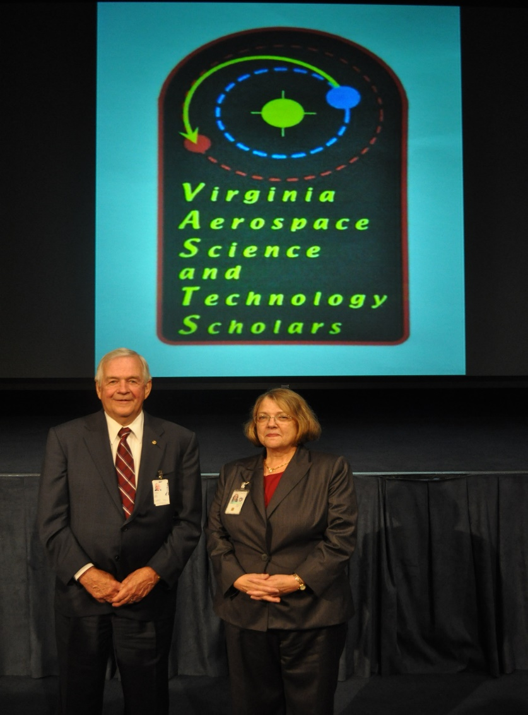
Joe May and Mary Sandy, Director of VASTS
JOE MAY SPEAKING BEFORE A NASA GROUP IN RICHMOND

Slide 11
Virginia Pathways Joe May Speaking to students at VA Tech

Slide 12
INVENTING
Some of your students may have potential in the area of inventing. I have done a presentation ambitiously titled “Inventing America” which is a discussion of inventing and some descriptions that I mentioned earlier.
I’d be pleased to come to your school for a group presentation. Details can be worked out with my Administrative Assistant.
We are developing some new aviation safety instruments for which might be of interest to your students.

Slide 13
Who Were the People Who Helped Me Most in my Career
J. Frank Hilllyard – Principal
Samuella Crim – Chemistry teacher
Margaret Martz – Physics teacher

Slide 14
observations
Properly done, technology provides some of the most rewarding opportunities available to an individual
If you don’t enjoy or perhaps feel comfortable with technology, I would recommend running not walking away from it as a source of your livelihood
You must have a high threshold for boredom if you are to succeed in STEM because long periods of intense concentration on an isolated topic is required
Thank you for the opportunity to share my thoughts and suggestions with you.
QUESTIONS?

