Slide 1
Bryan Marazzi
Sikorsky Aircraft
Mgr. Strategic Planning
bryan.m.marazzi@lmco.com

Slide 2
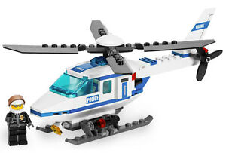
Career Started with Legos…

Slide 3
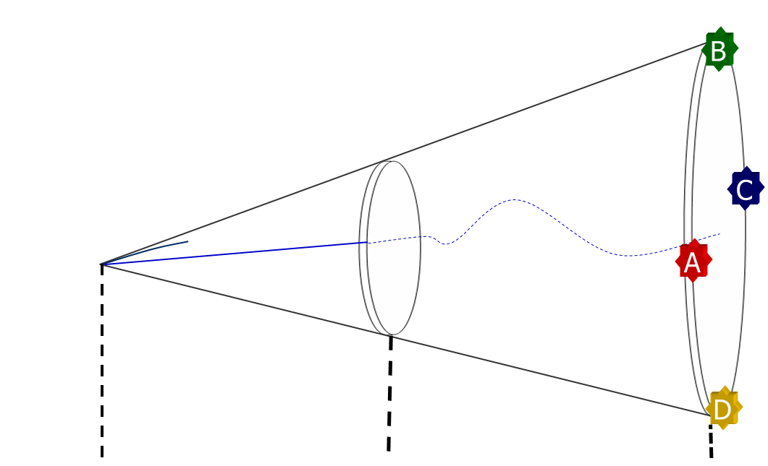
STEM Career Paths / Aerospace Industry
A: Tech Fellow / Chief Engineer / Model Engineer
Detail-oriented, analytical mindset
Deep technical expertise in a specific field
Knowledge through experience, specialty training
B: Manufacturing / Test / Customer Support Engr.
Schedule-oriented, “let’s try it” mindset
Hands-on role from the manufacturing floor to flight lines
Develop new processes / methods
C: Program Management
Schedule-oriented, ultimate planner mindset
Customer-facing role
Lead a cross-functional team from task to product level
D: Sales / Business Development / Strategy
Market-oriented, “big picture” mindset
Middle-man between customer and business
Communication and “soft-skills” required
Engineering
Degree
Mid-Career
Late Career

Slide 4
My Career So Far…
Education
Early Career
Today
2005-2009
B.S. Mechanical Engineering
Minor in Mathematics
-----------
2009 - 2016
Edison Engineering
Development Program
-----------
Design Engineer
-----------
Engineering Operations
Black Belt
-----------
Advanced Programs
2016 - Today
Competitive Intelligence Principal
----------
Strategic Planning
----------
Product Strategy
2010-2011
M.S. Manufacturing Engineering
Global Product Development

Slide 5
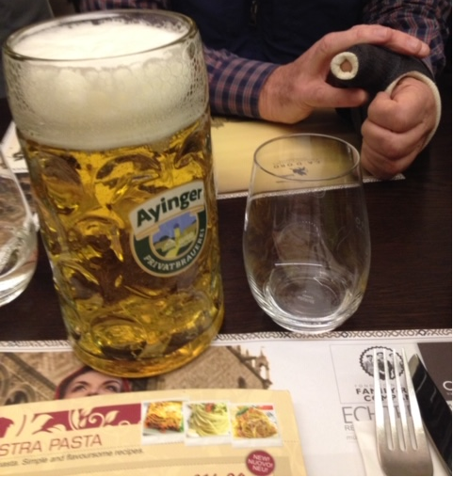
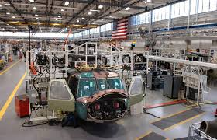
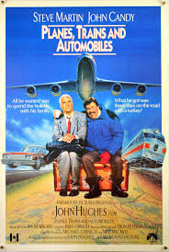
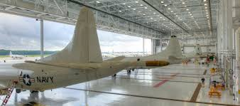
Global / Diverse Workplace
NAS Lemoore
Munich, Germany
CT
18hr Flight
DC
Eskişehir, Turkey
Visited and Managed Team in Bangalore
NAS Jacksonville

Slide 6
Skillsets Change Over Time
College & Early Career
Very Analytical
Detailed Design
Limited Exposure to Business
Mid-Career
Systems Engineering
Program Management Skills
Team building / leadership
Today
Business / Market Focused
Competitive Intelligence
Internal / External Communications
Very Analytical Team-Building Global Thinking
From Problem Solver to “Problem Finder”

Slide 7
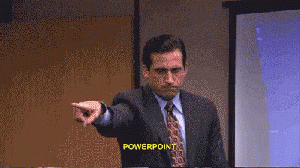
Current Role Strategic Planning / Product Strategy

Slide 8
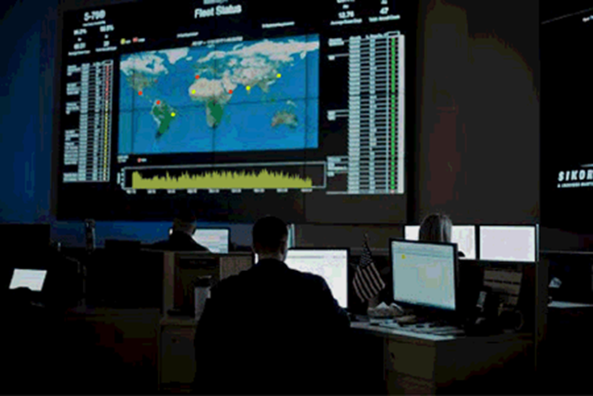
Strategic Planning
Products
Customers
Markets
Analyze macro-economic trends
Market analysis and forecasting
Data Analysis
Assess customer trends
Operations analysis
Competitive analysis
Investment decisions

Slide 9
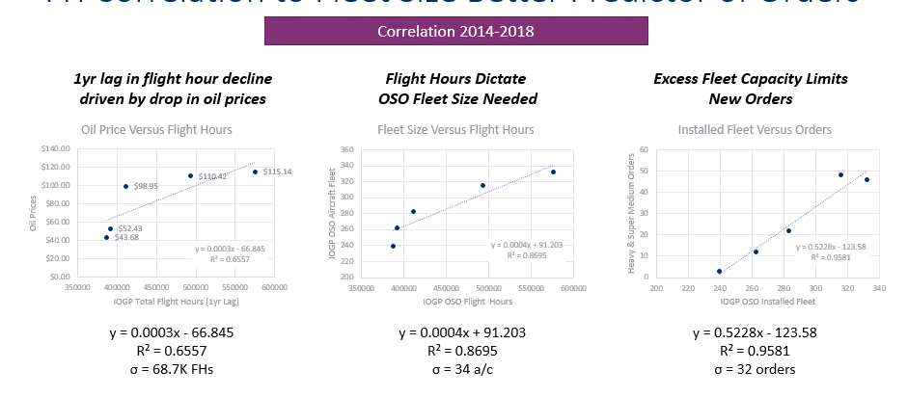
Example: Market Segment Forecasting

Slide 10
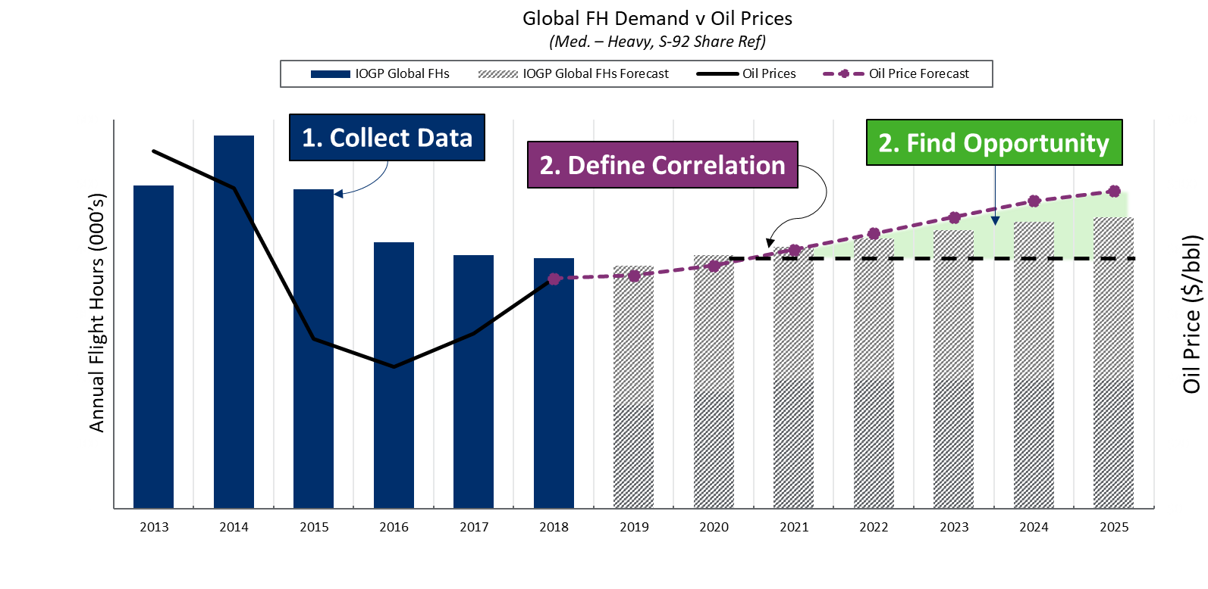
Example: Market Segment Forecasting

Slide 11
Product Strategy and the Product Lifecycle
Introduction
Growth
Maturity
Decline
Sustain
Harvest Value
Sales Volume ($)
Market Share
Create Demand
Time (Years)
Ref: https://hbr.org/1965/11/exploit-the-product-life-cycle

Slide 12
Closing Thoughts
STEM education gives you a basic foundation and skillset to build upon
Path you take is up to you… combine it with other skills / interests
Engineering is hard… but it pays off
Crazy stuff is happening right now… FLYING CARS!

