Slide 1
one it journey
Teachers build our future
DJ Garcia

Slide 2
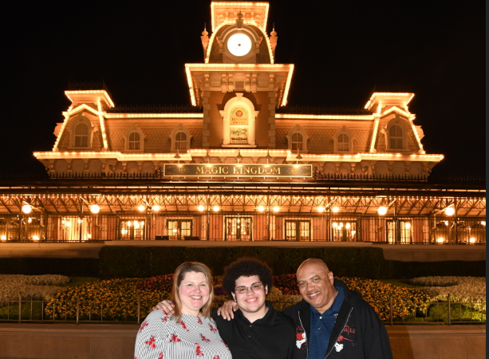








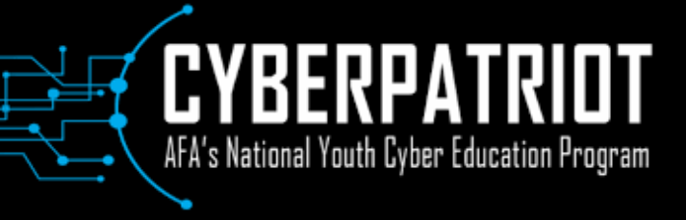


My Career Path
2003
2004
2018
2016
2006
START
2000
Network/Hardware Deputy
ISO Cyber Governance Manager
2012
Information Assurance Engineer
(Program)
Network
Engineer
Network Design Engineer
1989
1993
1998
Information Assurance Engineer
(Corporate)
Network
Admin
Mentor
Data Admin

Slide 3
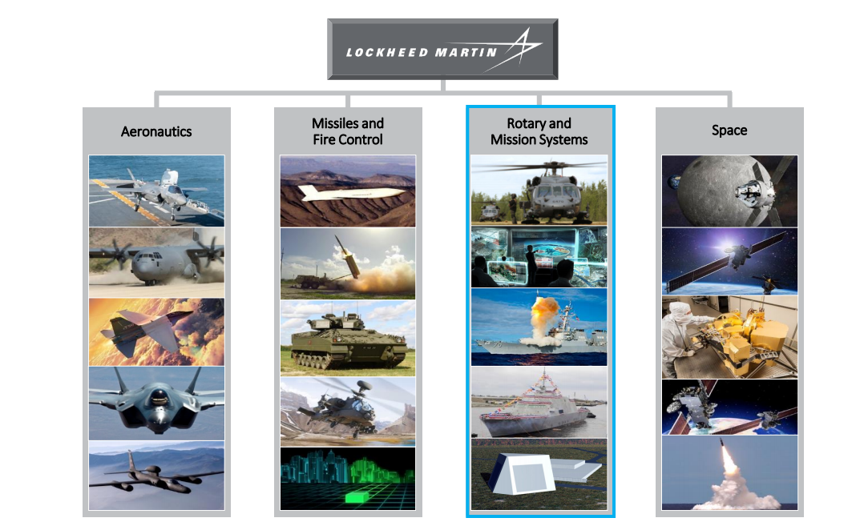
Lockheed martin cyber visibility
LOCKHEED MARTIN CYBER VISIBILITY
105,000 Employees
500+ Facilities
Over 70 Countries
145,000 Managed Desktops
92 Million Emails per Week
450 Million Web Hits per Day
8500 Programs
16,000 Suppliers
300 Customers

Slide 4

What I do
Cyber Governance Manager
Contract Data Protections
  Contract Terms and Conditions
Supply Chain Cybersecurity
  Cyber Posture
Regulatory Compliance & Requirements
  DoD and Commercial Customer
Audit Support
  ISO 27001
  AD 9100D
  Internal Audits
Corporate IT Policy
Mentoring

Slide 5
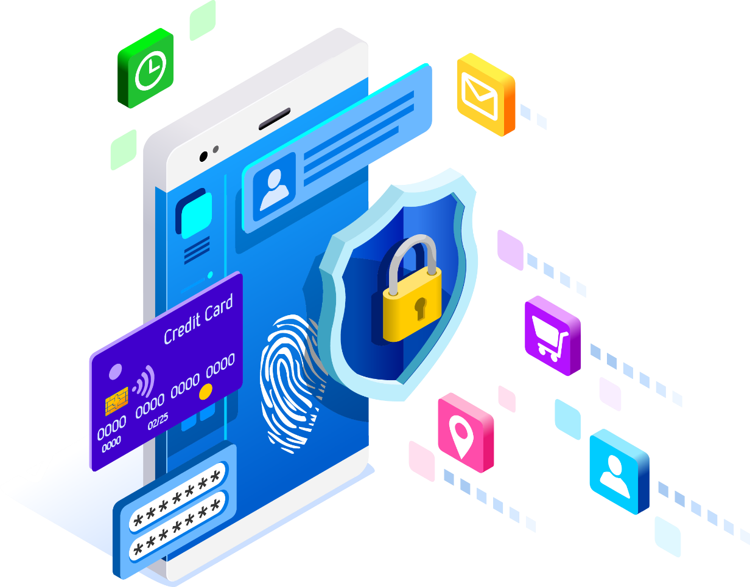
The Basics of Cyber
What is Cybersecurity?
  All the tools we use and actions we take to keep computers, networks, and information safe and available for those who need it, and unavailable for those who should not have it.
  That means protecting hardware and data from everything from hacktivists to earthquakes
Source: www.UMUC.edu

Slide 6

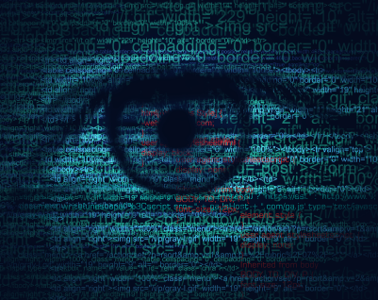
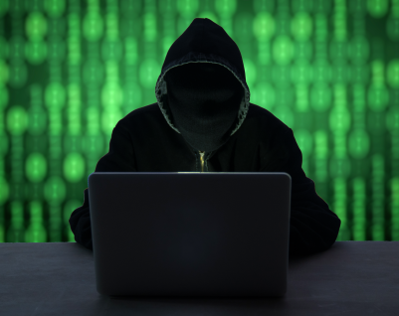
Why is it important?
Evolving Threats
Increasing
Potential Impact
CONFIDENTIALITY
INTEGRITY
AVAILABILITY
Increasingly
Unstable Threats
ADVANCED PERSISTENT THREATS (APT)
INSIDER
HACKTIVISTS
ROGUE ACTORS
BROADBASED
& CRIMINAL
The Only Constant is Change
Cybersecurity attacks continue to increase in frequency and sophistication for the Aerospace and Defense industry

Slide 7
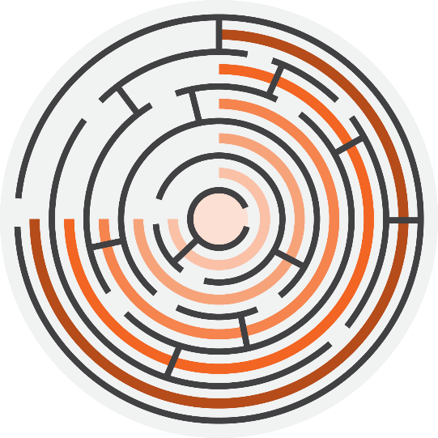
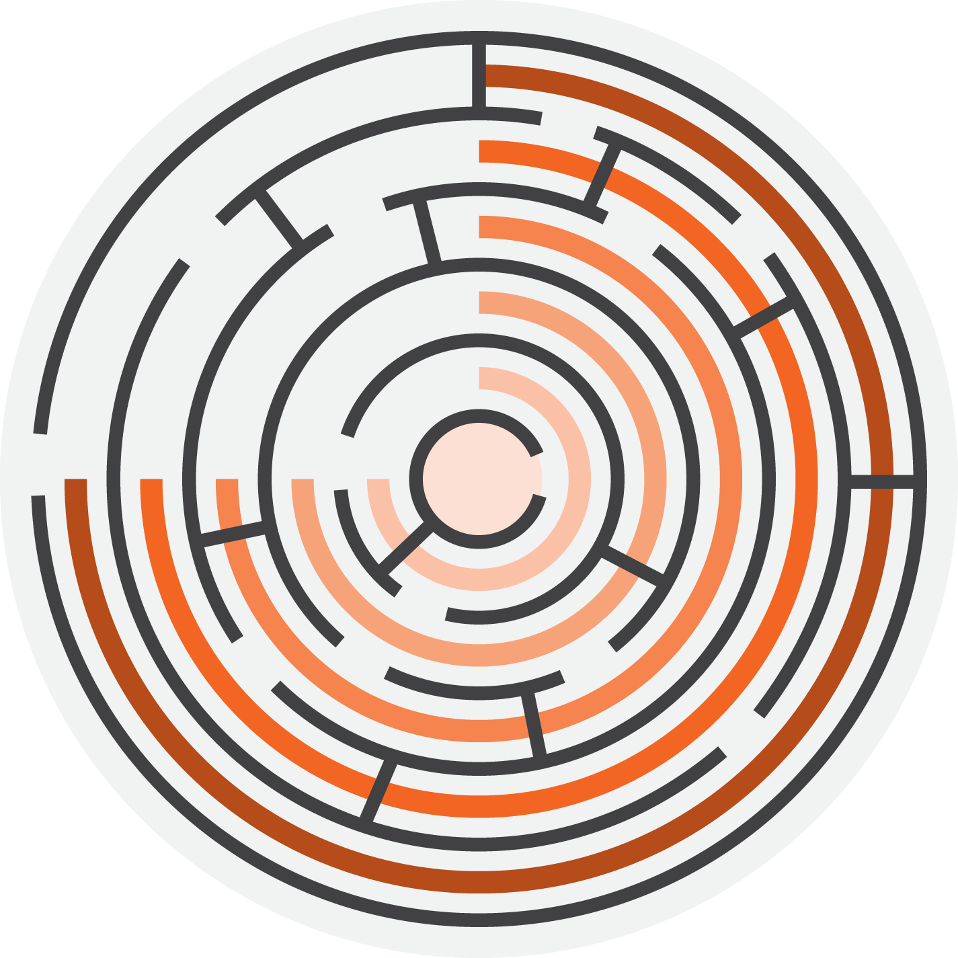
Why is it important?
Attackers Think in Graphs
Visibility & Control
Significantly Increase closer to the Corporate network
Vulnerability & Risk
Increase significantly the further away data moves from the corporate network
Social Media
Home Computer
Third Party Supplier
Extranet
Corporate
User Path
A typical user sees all IT systems as the same and leverages them equally
Adversary Path
Seeks opportunities to gain access at all layers of the IT ecosystem

Slide 8
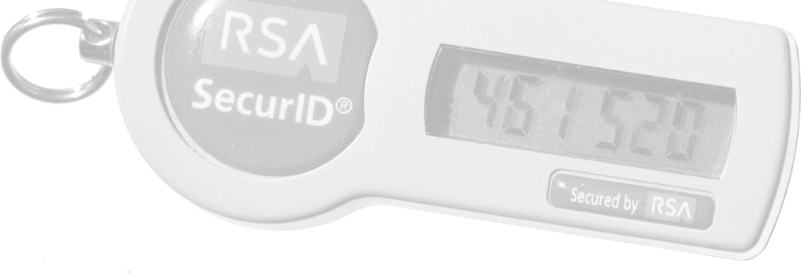
Why is it important?
Source: blogs.rsa.com
Case: RSA Security Services
  RSA: security firm that sells SecurID®
Attackers infiltrate RSA’s network through malware deployed in spoof emails sent to the company’s employees
Criminals capture the algorithms used to generate random SecurID® passwords
Criminals launch attack on Lockheed’s networks using the algorithms they stole from RSA
Lockheed Martin’s security team is able to thwart the attacks
Answer: We’re all connected
A weakness in one system can be exploited by attackers to target another system.
Source: InformationWeek, http://www.informationweek.com/security/risk-management/lockheed-martin-suffers-massive-cyberattack/d/d-id/1098013

Slide 9
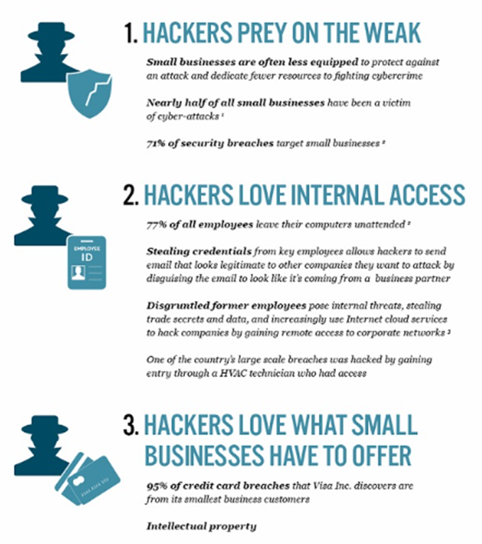
Why hackers love small business
The latest findings on data breaches confirm the appeal of small businesses:
According to the 2017 Verizon Data Breach Investigation Report, 61 per cent of breaches hit smaller businesses, up from the previous year’s 53 percent.
Symantec research found that 43 per cent of cyber attacks are lodged against small businesses.
The National Cyber Security Alliance found that 60 per cent of small companies are unable to sustain their businesses more than six months after a cyber attack.
Source: www.staysafeonline.com

Slide 10

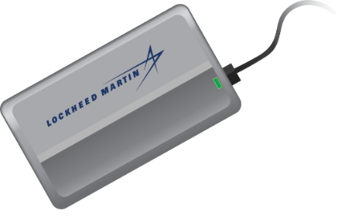
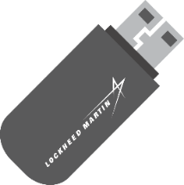

Adversaries motivations and vectors
Traditional Intrusion Vectors
E-mail
Data Storage Devices
Comp’d
Web Sites
Systems
Modern Intrusion Vectors
Social Media
Mobile
Supply Chain
Cloud

Slide 11





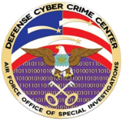
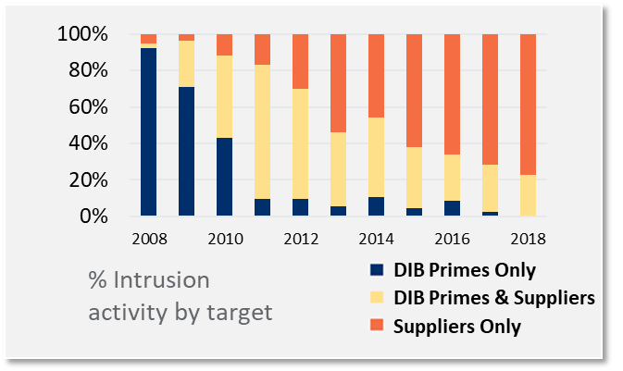
Complex Cyber Ecosystem
300+ Customers
Intel Sharing
100+ Partners
Lockheed Martin
Intrusion Activity
8,500+ Programs
Supply Chain
16,000+ Suppliers
APT
xx Campaigns

Slide 12

DFARS/NIST Implementation
Getting Started 
A reasonable first step may be for company personnel with knowledge of their information systems security practices to
read through NIST 800-171 special publication,
examining each requirement
determine if it may require a change to company policy or processes, a configuration change for existing company information technology (IT), or if it requires an additional software or hardware solution. Most requirements

Slide 13
NIST 800-171
14 Control Families
3.1 Access Control
3.8 Media Protection
3.2 Awareness and Training
3.9 Personnel Security
3.3 Audit and Accountability
3.10 Physical Protection
3.4 Configuration Management
3.11 Risk Assessment
3.5 Identification and Authentication
3.12 Security Assessment
3.6 Incident Response
3.13 System and Communications Protection
3.7 Maintenance
3.14 System and Information Integrity

Slide 14
What makes a good it/cyber candidate
Interested
Curious
See adjacencies
Builder
Creater
Big Picture
Detail orientated
Fast pace
Slow pace
TEAMWORK
IT & Cyber Field is broad

Slide 15
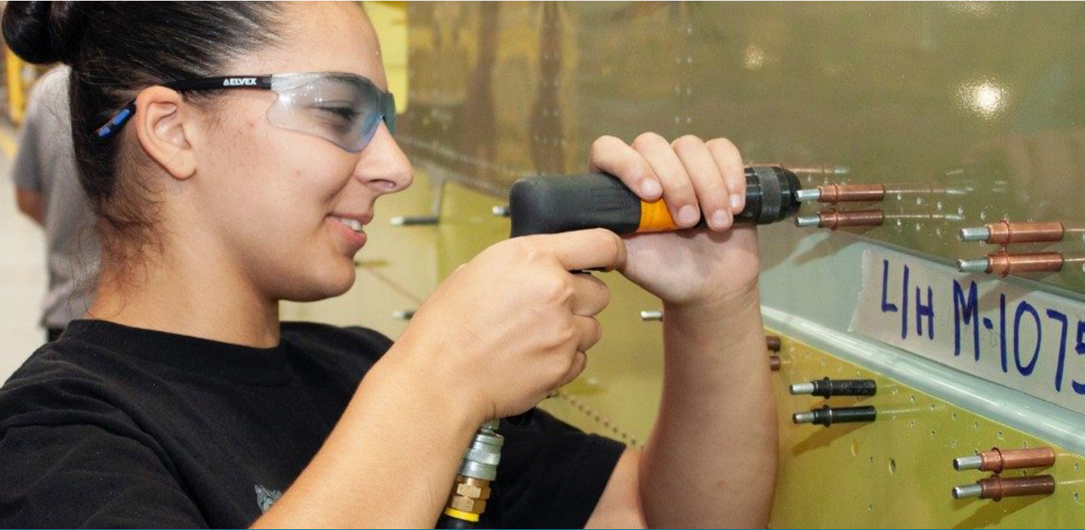

Lockheed Martin in the Community
Lockheed Martin CYBERQUEST
Great Minds in STEM
Girls Inc
Project Lead the Way
Team America Rocketry Challenge
Engineers in the Classroom
FIRST Robotics
STEM Scholarship
Vocational Scholarship
CyberGrants

