Slide 1
Pipeline Safety – Texas STEM Teachers
Ajit Kulkarni
November 12th, 2020

Slide 2
Questions by Poll
Do you use Natural Gas in your household?

Slide 3
Questions by Poll
Do you know how you get Natural Gas in your house?

Slide 4
Questions by Poll
Do you know the safest way for Natural Gas transport from producers to customers?

Slide 5
Agenda
About myself
TC Energy and Pipeline Safety
Pipeline Facility – Compressor Stations
How does TCE makes the pipelines safer?
Pipeline Markers and Leak Prevention

Slide 6
Ajit Kulkarni
Education –
B. E. Mechanical Engineering
M.S. Industrial Engineering
P.E. examination in Thermal and Fluids
Engineering Manager at TC Energy - Growth Projects
15 years experience in Projects, Engineering, Compression, etc.
Design and engineering of compressors, Compressor Stations, meter stations and pipelines
Notes:
Passion has been playing with machines
Physics and Math have been my favorite subjects

Slide 7
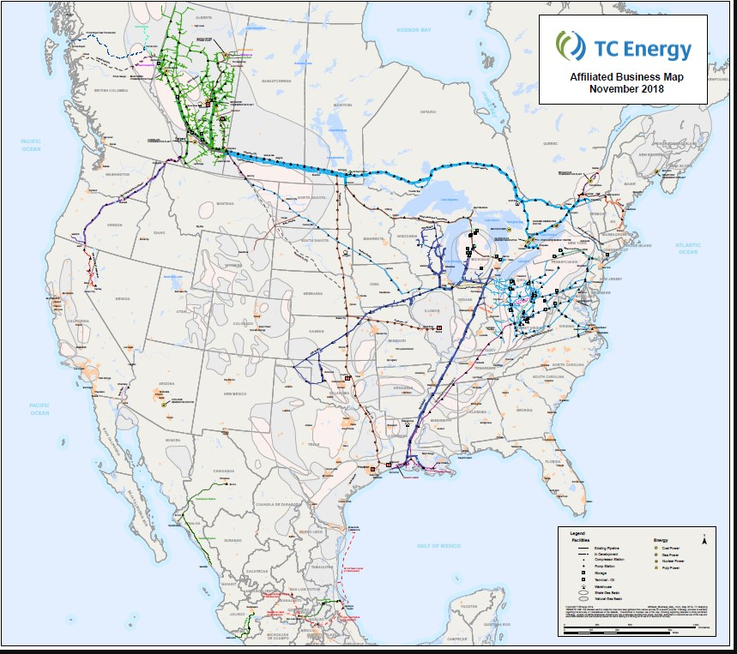
TC Energy Overview
TC Energy
Delivering the energy people need, every day.
We deliver the energy people need every day – safely, responsibly, collaboratively and with integrity.
Operations in USA, Canada and Mexico
TC Energy operates more than 56,000 miles of natural gas pipeline
Delivers about 25 percent of natural gas used in North America every day.

Slide 8
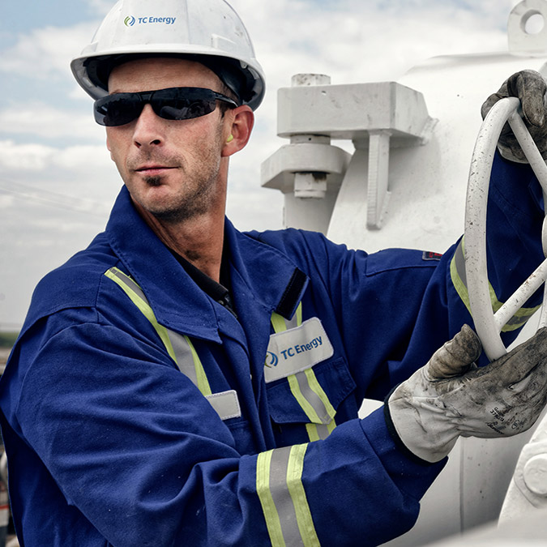
Two reasons we need pipelines
Pipelines bring you essential energy
Pipelines transport energy safely
Notes:
We all need Energy from charging our smart phones to charging Tesla car battery
Demand for Energy is increasing

Slide 9
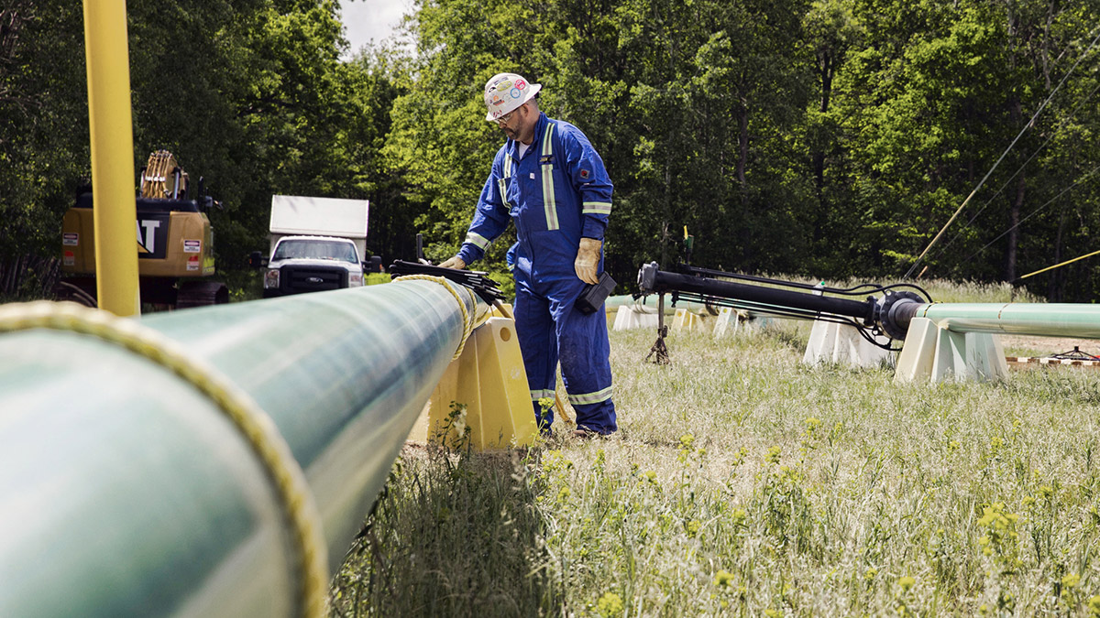
Pipeline Safety
Pipelines are the safest and most cost-effective means to transport the extraordinary volumes of natural gas and hazardous liquid products that fuel our economy.
Over 99.999 per cent of all pipeline deliveries are made safely each year
Pipelines are approximately 4.5 times safer than rail (though both are very safe)
Pipelines have robust operations and integrity management programs
Pipelines are stringently regulated across North America, with some of the world’s highest standards of safety and integrity
Notes:
To move the volume of even a modest pipeline, it would take a constant line of tanker trucks, about 750 per day, loading up and moving out every two minutes, 24 hours a day, seven days a week.
The railroad-equivalent of this single pipeline would be a train of seventy-five 2,000-barrel tank rail cars everyday.
These alternatives would require many times the people, clog the air with engine pollutants, be prohibitively expensive and — with many more vehicles on roads and rails carrying hazardous materials — unacceptably dangerous.

Slide 10
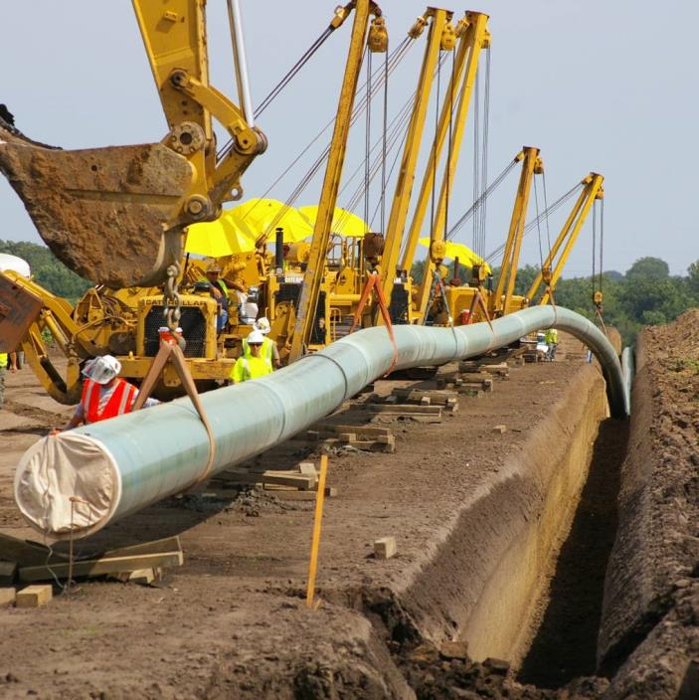
Pipelines
Pipelines are located within pipeline easements, called Right-of-Ways (ROW)
Contains welded steel pipe, approximately ¼ to ½ inch thick
Buried a minimum of 4 feet below grade for oil and 3 feet for natural gas
Under navigable waterways at a minimum of 4 feet
Notes:
Pipelines are everywhere!
Pipelines operate at 400-1000 psig and require booster compressor stations in order to maintain the pressure for efficient transport

Slide 11
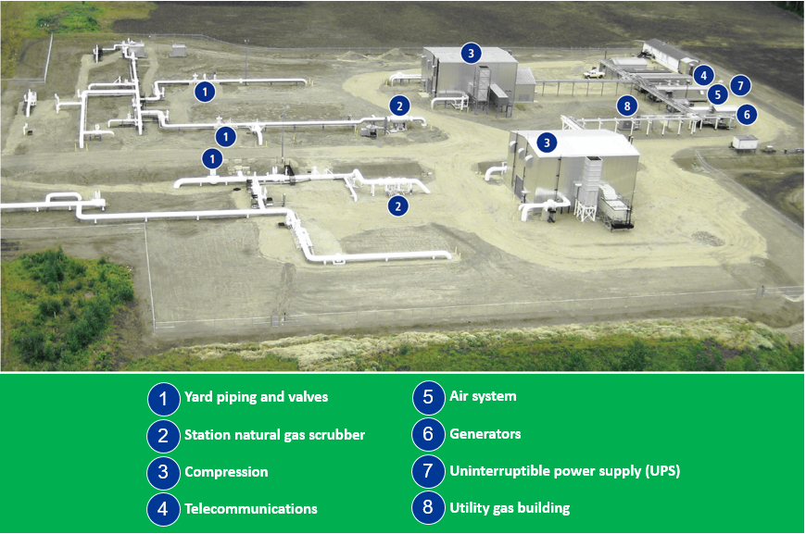
Pipeline Facility Sites – Compressor Station
Notes:
May contain compressors, pumps, valves, meters, sumps, pig launchers, electrical substation and pump controls and ancillary equipment
Allow for maintenance of valves and equipment
Mechanically, they can be complex within multiple connections to pipeline systems
Manned or operated remotely

Slide 12
Critical Components of Compressor Station
Tie-in Valves
Filtration of the gas
Reciprocating or Centrifugal Compressor
Driver such as Gas Turbines or Electric Motors
Gas Aftercoolers
Gas Piping per ASME B31.8 and utility piping per B31.3
Blowdown Valves and Emergency Valves
Utility systems such as building heat, electric generator, air compressor
Instrumentation, Control panels, control system, etc.

Slide 13
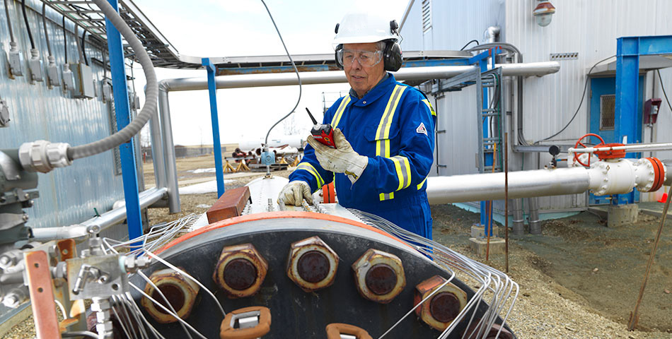
How does TCE makes the pipelines safer?
Maintenance
Aerial Patrol
Leak Detection
Cover Surveys
Geotechnical monitoring
Hydrostatic testing
In-line inspection
Investigative digs
Valve maintenance
Notes:
TC Energy has an extensive Pipeline Maintenance Program (PMP) to monitor, inspect and repair our pipeline facilities. Regular maintenance activities include:
• Aerial patrol – We regularly inspect the pipeline route from low-flying helicopters and airplanes. The pilots look for hazards to the pipeline from outside sources (e.g. unauthorized activity, soil disturbances) that could affect the integrity of our pipeline system.
• Leak detection - We regularly use sensitive leak detection equipment on aerial patrols of our natural gas pipelines to detect leaks. Sophisticated computational leak detection systems are used in addition to visual aerial patrols to identify leaks on our assets.
• Cover surveys – We investigate areas where we suspect wind or water erosion may have reduced the depth of ground cover over our pipelines so we can maintain the integrity of the pipe.
• Geotechnical monitoring – Our pipelines cross thousands of bodies of water and significant slopes. All of these are monitored for erosion and movement during aerial patrol. More active slopes and streams are monitored more thoroughly through a variety of survey techniques.
• Hydrostatic testing – We can verify the integrity of our pipeline by removing natural gas from the pipeline, replacing the gas with water and then pressurizing the pipeline to a level far greater than it experiences during normal operation. If a leak occurs during testing, TC Energy will repair or replace the affected section of pipe.
• In-line inspection – In-line inspection, also referred to as ‘pigging,’ looks for any locations where corrosion may have occurred. Specialized internal inspection devices called ‘smart pigs’ travel through the pipeline collecting data. The data is then analyzed to determine if there are areas of concern requiring further investigation.
• Investigative digs – We conduct investigative digs based on the data analysis from pigging and other information. Sections of pipeline
are excavated to investigate their condition and to ensure integrity.

Slide 14
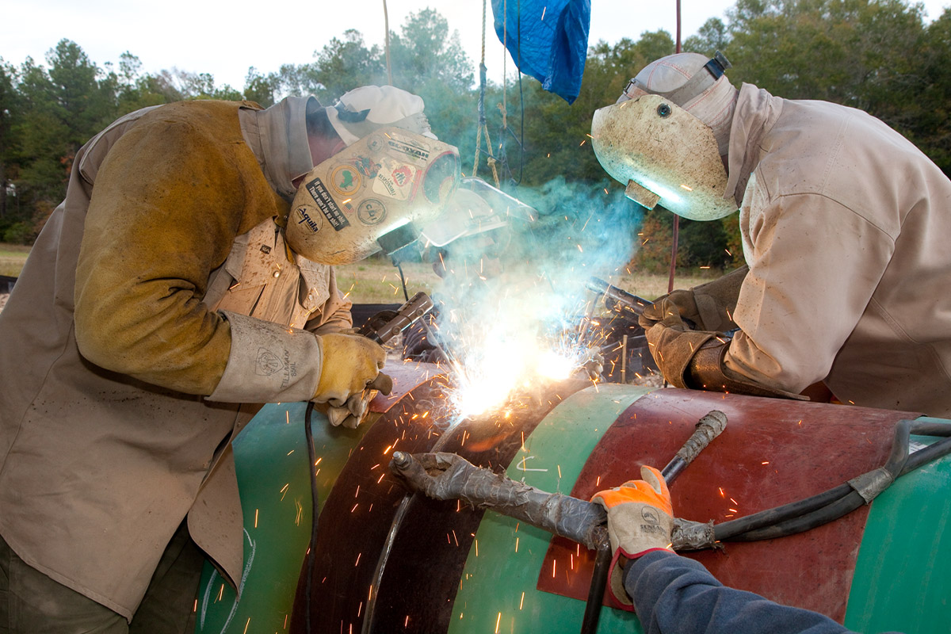
How does TCE makes the pipelines safer?
Design
Construction
Operation
Environmental Practices
Notes:
Design
TC Energy uses top quality steel and welding techniques throughout our natural gas and oil pipeline systems. We take additional safety precautions where pipelines cross roads, railway tracks, waterways and in areas of higher population.
Construction
During construction, all welds are checked by an x-ray or ultrasonic process to ensure the welds are sound. To protect against corrosion, the external surface of the pipeline is coated.
Operation
During operations, a very low-voltage electrical current – called cathodic protection – is applied to the pipe. The applied current protects the pipe from corrosion
in areas where coatings may have been compromised. The cathodic protection system is monitored on a monthly basis to ensure proper operation. The entire transmission system is monitored 24 hours a day by highly trained TC Energy employees from a computerized control center. From here, we are able
to detect changes in pressure along our pipelines and ensure that all facilities are operating properly.
Environmental practices
Prior to any ground disturbance, TC Energy ensures that site-specific environmental protection measures are incorporated to ensure equivalent land capability is maintained. At TC Energy, this includes minimizing and mitigating effects on soil, water, wildlife and vegetation.

Slide 15
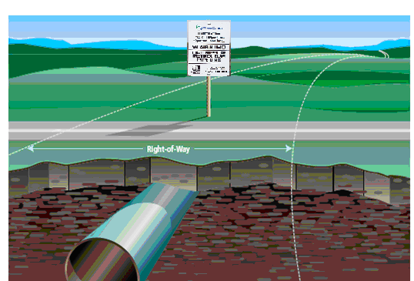
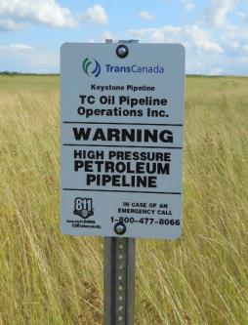
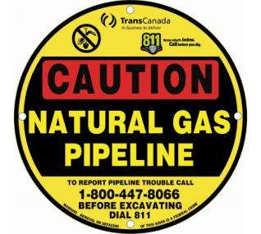
Pipeline Warning Signs & Markers
Every pipeline location will be marked at:
Roads
Railroads
Canals (waterways)
Other areas deemed necessary
Pipeline markers must contain:
Emergency contact numbers for the pipeline operator
Product being transported
Company name and information

Slide 16
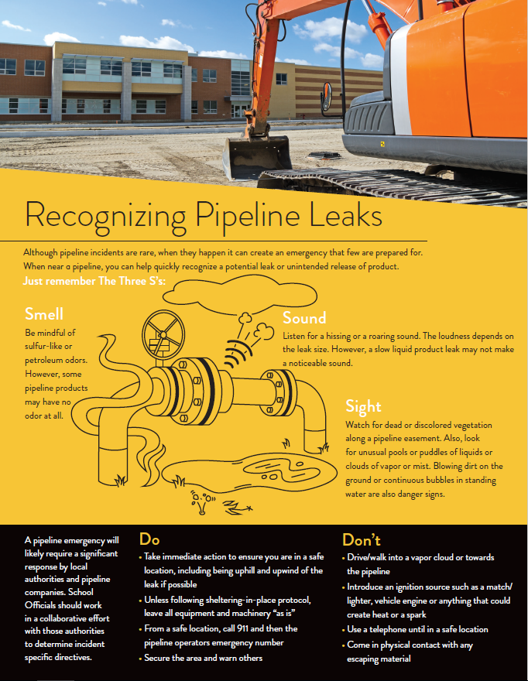
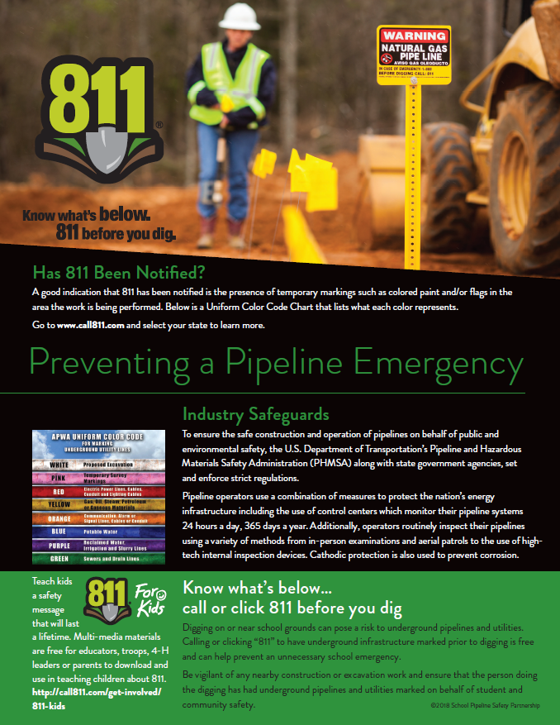
Recognizing pipeline leaks and 811

Slide 17
References and Additional Resources
Common Ground Alliance – Best Practices (CGA) www.commongroundalliance.com
Know What’s Below – Call 811 Before You Dig www.call811.com
Pipeline Association of Public Awareness (PAPA) www.pipelineawareness.org
TC Energy www.tcenergy.com
National Pipeline Mapping System www.npms.phmsa.dot.gov
www.solarturbines.com

