Slide 1
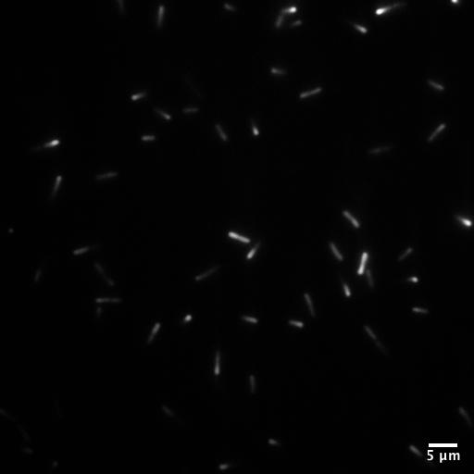
Rigid Body Dynamics of
Motile Bacteria near Surfaces
Orrin Shindell – Department of Physics & Astronomy, Trinity University, San Antonio, TX
Center for Excellence in Education – November 12, 2020
Notes:
Different Images

Slide 2
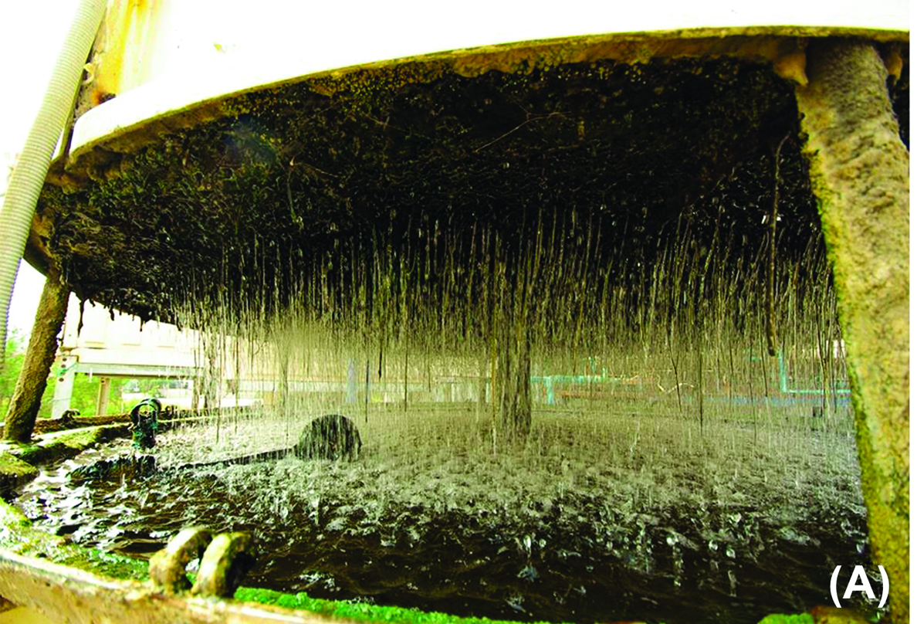
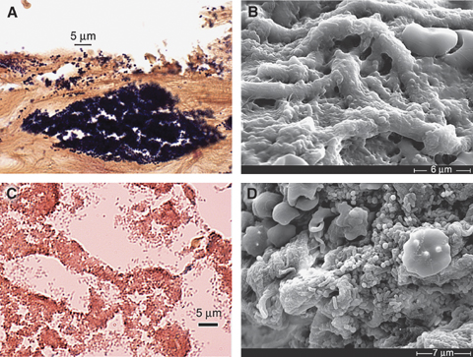
Industry and Medicine
Biofouling
Chronic Wounds
Wound Repair and Regeneration, Volume: 16, Issue: 1, Pages: 37-44, First published: 13 December 2007, DOI: (10.1111/j.1524-475X.2007.00321.x)

Slide 3
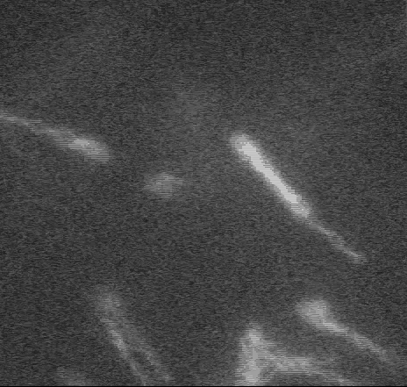

Bacterial Dynamics
https://www.rowland.harvard.edu/labs/bacteria/movies/index.php
$$≈5 μm$$

Slide 4
Evolution: Surface Interactions
Escherichia coli
Cell Body
Flagellum
Surface
Notes:
Make all these bigger!

Slide 5

Physics of E. coli Motility
$$F_{drag}$$
$$F_{propulsion}$$
$$v$$
$$F_{drag}=F_{propulsion}$$
Notes:
Make all these bigger!

Slide 6
Physics of E. coli Motility
$$ω_{body}$$
$$ω_{flagellum}$$
$$v$$

Slide 7
Physics of E. coli Motility
$$ω_{body}$$
$$ω_{flagellum}$$
$$v$$

Slide 8
Physics of E. coli Motility
$$F_{flagellum}$$
$$ω_{bacterium}$$
$$F_{body}$$

Slide 9

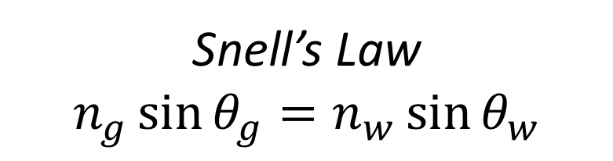



Internal Reflection
$$n_{water}≈1.3$$
$$θ_{w}$$
$$n_{glass}≈1.5$$
$$θ_{g}$$
Snell’s Law
$$n_{g}\sin{θ_{g}}=n_{w}\sin{θ_{w}}$$
Notes:
Observation at the end: The density of the intact regions appears uniform.

Slide 10

Total Internal Reflection
$$θ_{c}$$
Maxwell’s Equations
Continuity of Fields
Notes:
Observation at the end: The density of the intact regions appears uniform.

Slide 11
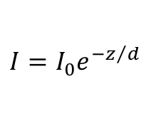

The Evanescent Field
$$z$$
$$I=I_{0}e^{−z/d}$$
Notes:
Observation at the end: The density of the intact regions appears uniform.

Slide 12
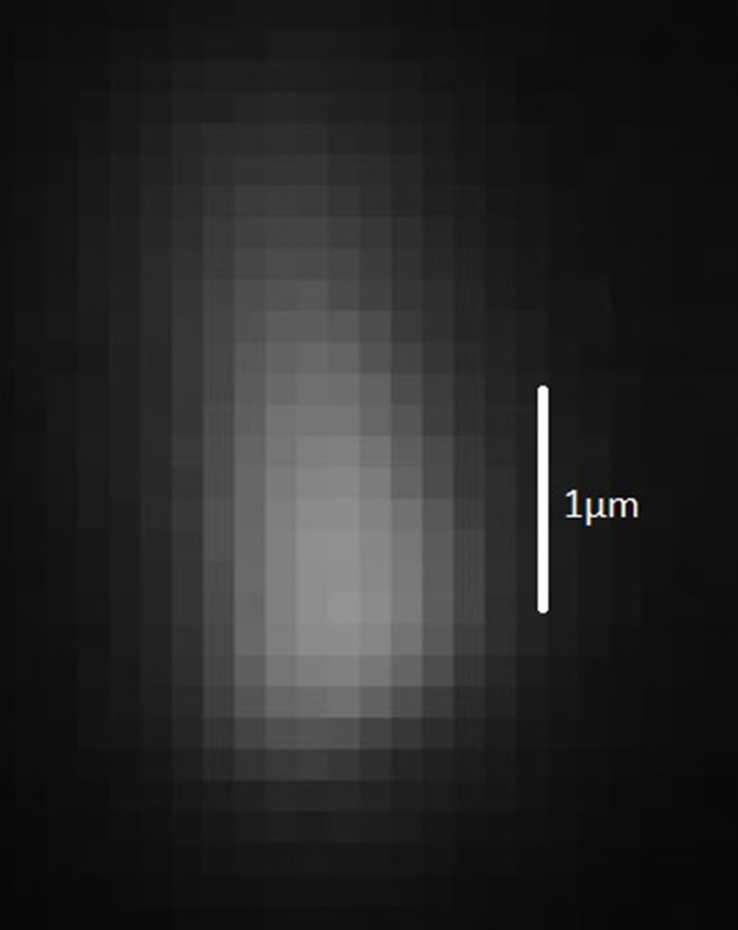
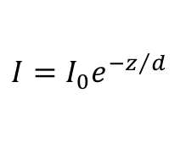

Total Internal Reflection Fluorescence
Water
$$z$$
$$I=I_{0}e^{−z/d}$$
Glass
Oil
TIRF Objective
CCD Camera
Credit: Keaton Holt

Slide 13
Raw Data (real time 25 fps)

Slide 14
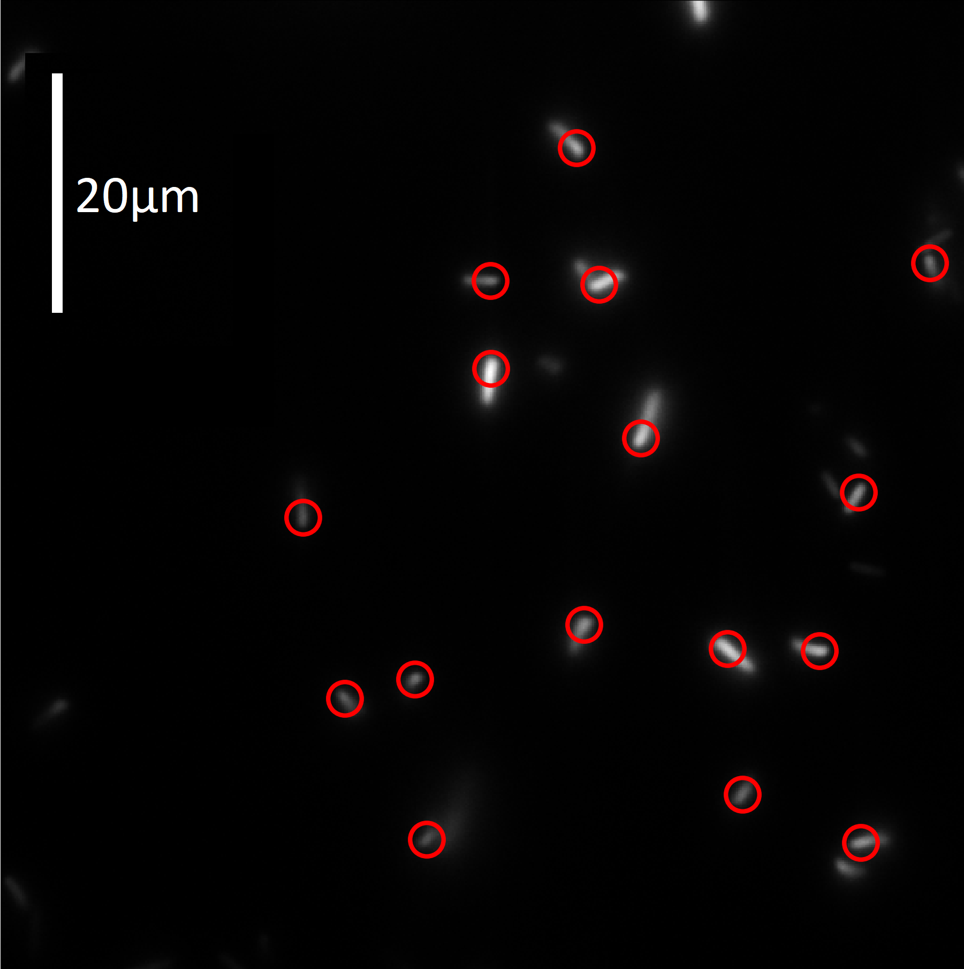
Tracking
Credit: Keaton Holt and Mikayla Greiner

Slide 15
Goal: Ellipsoidal-Model Fitting
Credit: Mikayla Greiner

Slide 16





Five Coordinates
$$z$$
$$θ$$
$$y$$
$$φ$$
$$x$$

Slide 17


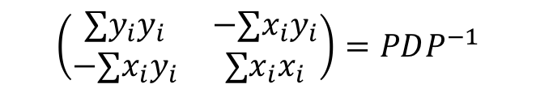
$φ$ from the Inertia Matrix
$$φ≈{150}^{∘}$$
$$\left(\begin{matrix}∑y_{i}y_{i} & −∑x_{i}y_{i} \\ −∑x_{i}y_{i} & ∑x_{i}x_{i}\end{matrix}\right)=PDP^{−1}$$

Slide 18
Hypothetical Object Intensity
ellipsoid
object intensity

Slide 19
Point Spread Function

Slide 20
Point Spread Function

Slide 21
Convolution

Slide 22


Hypothetical Image Intensity
object intensity
point spread function
Image intensity
$$∗$$
$$=$$
Notes:
Eliminate 2 of the y-axes. The space between boxes could be smaller.

Slide 23
Comparison
Credit: Mikayla Greiner

Slide 24
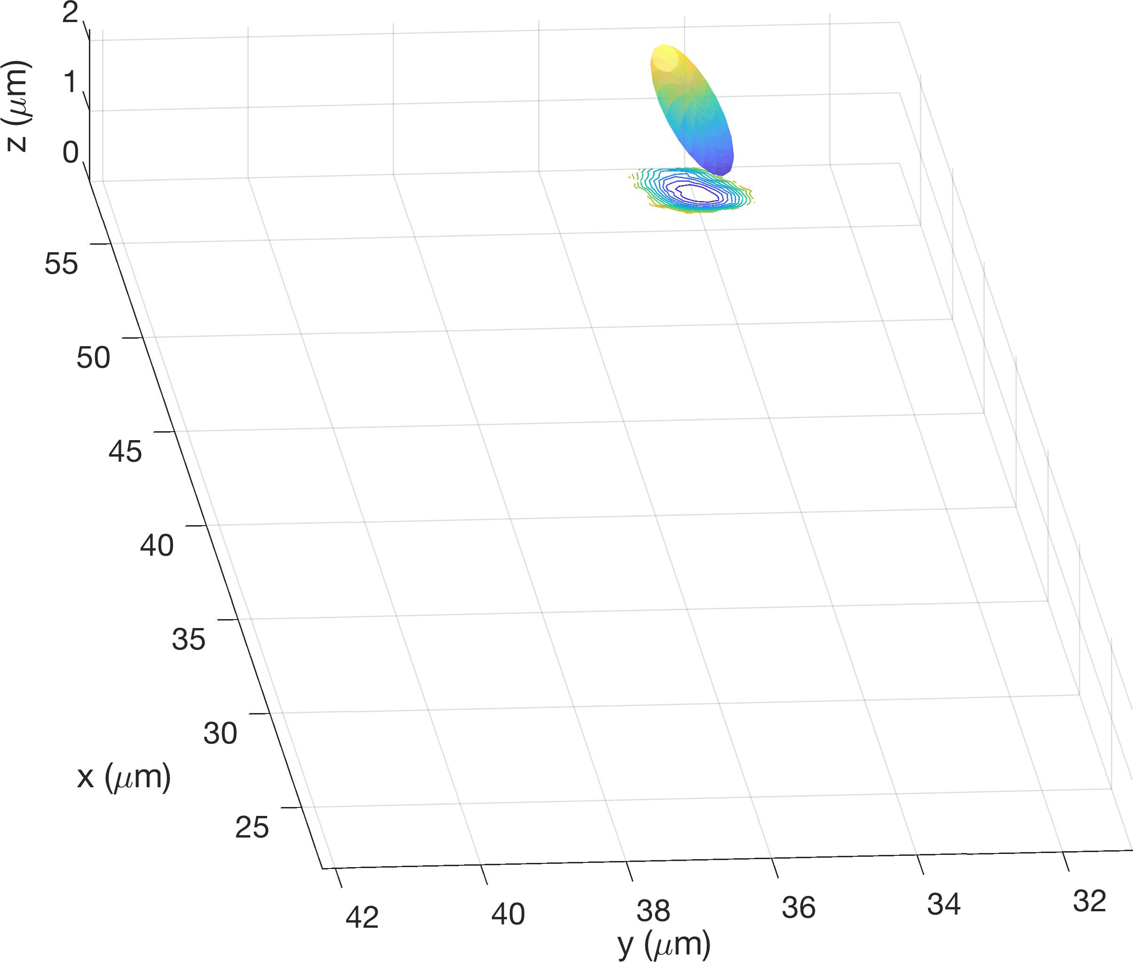
Reconstruction (10 fps)
Credit: Mikayla Greiner

Slide 25
Still Trajectory

Slide 26
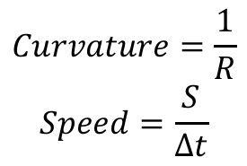


Fitting Circles
$$R$$
$$S$$
$$Curvature=\frac{1}{R}$$
$$Speed=\frac{S}{Δt}$$
Credit: Mikayla Greiner

Slide 27
Trajectory Measurements
Credit: Keaton Holt

Slide 28




Orientation Measurements
$$z$$
$$θ$$
$$y$$
$$x$$
Credit: Keaton Holt

Slide 29
Acknowledgements
Mikayla Greiner
Department of Physics, Trinity University, San Antonio, TX
Hoa Nguyen
Department of Mathematics, Trinity University, San Antonio, TX
Keaton Holt
Department of Physics, Trinity University, San Antonio, TX
Frank Healy
Department of Biology, Trinity University, San Antonio, TX
Quan Hoang
Department of Mathematics, Mechanics and Informatics, Vietnam National University;
Bruce Rodenborn
Department of Physics, Centre College, Dansville, Kentucky
Nicholas Coltharp
Department of Mathematics, Trinity University, San Antonio, TX
Dung Hoang
Department of Mathematics, Mechanics and Informatics, Vietnam National University

